Slide 1
CSE/T/324A Computer Networks Topic 1- Introduction
Sarbani Roy
sarbani.roy@jadavpuruniversity.in
Office: CC-5-7
Cell: 9051639328

Slide 2
Syllabus
Introduction: Uses of Computer Networks, Types of Computer Networks, OSI Reference Model, TCP/IP model [4L]
Review of Physical Layer [4L]
Data Link Control and Protocols: Link Layer Services, Error detection and Correction Techniques, Multi Access Protocols, Link Layer Addressing, Ethernet, Hubs, Switches and Switches, Point to Point Protocol, Asynchronous Transfer Mode, Multiprotocol Label Switching [6L]
Network Layer: Introduction, Virtual Circuit and Datagram Networks, IP Addressing, Subnetting, Routing Algorithms (Link State, Distance Vector, Hierarchical), Routing in the Internet (RIP, OSPF, BGP), Broadcast and Multicast Routing Algorithms, Routers, ICMP, IPv6 [8L]
Transport Layer: Introduction to Transport Layer Services, Multiplexing and Demultiplexing, Connectionless Transport: UDP, Principles of Reliable Data Transfer, Connection Oriented Transport: TCP, Principles of Congestion Control, TCP Congestion Control, Sockets and Socket Programming, Quality of services (QOS) [8L]
Application Layer: Web and HTTP, Domain Name Space (DNS), Electronic Mail (SMTP, MIME, IMAP, POP3), File Transfer Protocol, Cryptography [6L]
Introduction to Wireless and Mobile Networks [4L]

Slide 3
COs of Theory
CO1: Understand the layered architecture and explain the contemporary issues and importance of MAC sublayer of the Data Link Layer, network layer, transport layer and application layer of TCP-IP model, and how they can be used to assist in network design and implementation.
CO2: Understand the protocols of MAC sublayer of the Data Link Layer and describe the IEEE standards for Ethernet (802.3) and wireless LAN (802.11).
CO3: Understand internetworking principles and explain algorithms for multiple access, routing and different networking techniques and able to analyze the performance of these algorithms.
CO4: Explain the protocols in Transport Layer and able to design network applications using these protocols.
CO5: Explain the protocols in application layer and how they can be used to design popular internet applications.

Slide 4
COs of Lab
CO1: Design and implement error detection techniques within a simulated network environment.
CO2: Design and implement flow control mechanisms of Logical Link Control of Data Link Layer within a simulated network environment.
CO3: Design and implement medium access control mechanisms within a simulated network environment using IEEE 802 standards.
CO4: Design and implement network layer protocols within a simulated network environment or network tools using IEEE 802 standards.
CO5: Design and implement various applications using Transport layer protocols and Application layer protocols for its implementation in client/server environment and analyze the performance.

Slide 5
Suggested Readings
Data Communications and Networking, Behrouz A Forouzan, McGraw Hill
Computer Networks, by Andrew S. Tanenbaum, Prentice Hall India
Computer Networking: A Top-Down Approach Featuring the Internet, by James F. Kurose and Keith W. Ross, Pearson Education
Slides are mainly prepared using online documents available of the above books and course materials of different institutes

Slide 6
Review of Error Detection in Data Link Layer

Slide 7
Computer Networks Lab CO1: Design and implement error detection techniques within a simulated network environment.

Slide 8
Error Detection
Data transmission can contain errors
Single-bit
Burst errors of length n (n: distance between the first and last errors in data block)
How to detect errors
If only data is transmitted, errors cannot be detected → Send more information with data that satisfies a special relationship → Add redundancy

Slide 9
Error Detection Methods
Vertical Redundancy Check (VRC)
Append a single bit at the end of data block such that the number of ones is even → Even Parity (odd parity is similar) 0110011 → 01100110 0110001 → 01100011
VRC is also known as Parity Check
Performance:
Detects all odd-number errors in a data block

Slide 10
Error Detection Methods
Longitudinal Redundancy Check (LRC)
Organize data into a table and create a parity for each column
11100111 11011101 00111001 10101001
11100111
11011101
00111001
10101001
10101010
11100111 11011101 00111001 10101001 10101010
Original Data
LRC

Slide 11
Error Detection Methods
Performance:
Detects all burst errors up to length n (number of columns)
Misses burst errors of length n+1 if there are n-1 uninverted bits between the first and last bit
Checksum
Used by upper layer protocols
Similar to LRC, uses one’s complement arithmetic

Slide 12
Cyclic Redundancy Check
Powerful error detection scheme
Rather than addition, binary division is used → Finite Algebra Theory (Galois Fields)
Can be easily implemented with small amount of hardware
Shift registers
XOR (for addition and subtraction)

Slide 13
Cyclic Redundancy Check
Let us assume k message bits and n bits of redundancy
Associate bits with coefficients of a polynomial 1 0 1 1 0 1 1 1x⁶+0x⁵+1x⁴+1x³+0x²+1x+1 = x⁶+x⁴+x³+x+1
xxxxxxxxxx yyyy
Block of length k+n
k bits
n bits

Slide 14
Example
Send
M(x) = 110011 → x⁵+x⁴+x+1 (6 bits)
P(x) = 11001 → x⁴+x³+1 (5 bits, n = 4) → 4 bits of redundancy
Form x^{n}M(x) → 110011 0000 → x⁹+x⁸+x⁵+x⁴
Divide x^{n}M(x) by P(x) to find C(x)
Receive
No remainder
→ Accept
= C(x)
Send the block 110011 1001

Slide 15
Cyclic Redundancy Check
Let M(x) be the message polynomial
Let P(x) be the generator polynomial
P(x) is fixed for a given CRC scheme
P(x) is known both by sender and receiver
Create a block polynomial F(x) based on M(x) and P(x) such that F(x) is divisible by P(x)

Slide 16
Cyclic Redundancy Check
Sending
Multiply M(x) by x^{n}
Divide x^{n}M(x) by P(x)
Ignore the quotient and keep the reminder C(x)
Form and send F(x) = x^{n}M(x)+C(x)
Receiving
Receive F’(x)
Divide F’(x) by P(x)
Accept if remainder is 0, reject otherwise

Slide 17
Assignment 1: Design and implement an error detection module. Due on: 19-23 October 2020 (in your respective lab classes)
Design and implement an error detection module which has four schemes namely LRC, VRC, Checksum and CRC. Please note that you may need to use these schemes separately for other applications (assignments). You can write the program in any language. The program should accept the name of a test file (contains a sequence of frames) from the command line and then print the input data frame, signature block and the output data frame on console standard output. Next, test the same program to produce a PASS/FAIL result for following cases.
(a) Error is detected by all four schemes. Use a suitable CRC polynomial (list is given in next page).
(b) Error is detected by checksum but not by CRC.
(c) Error is detected by VRC but not by CRC.
[Note: Inject error in random positions in the input data frame. Write a separate method for that]
Please note that your design and implementation of these schemes can help you to make your assignment different from your classmates. Write the code by yourself and protect your code. The assignment is simple, but we encourage you to do improvisation with this.

Slide 18
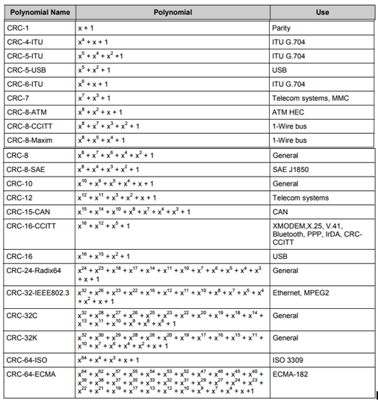

Slide 19
Report
Title: (Basic information like name, class, group, assignment number, problem statement and date (deadline and submission)).
Design: (short paragraph describing the purpose of the program, draw a structure diagram to reflect the procedural organization of the program as you have designed it in the previous step, input and output format)
Implementation: (code snippet, method description, interfaces etc.)
Test cases: (Describe the tests you will perform to verify the correctness of your program. This should be a thorough and exhaustive list of test cases designed to show that your program does everything it is supposed to do. The combined tests should exercise every line of code in your program. For each test case, give sample test data and state what you are checking.
Results: (Figures or graphs, tables )
Analysis: (discussion on results considering different test cases, error, correctness, known bugs, possible improvements)
Comments: Evaluate the lab assignment. What did you learn from it? Was it too hard? (explain why?) Too easy? (explain why?) Suggest improvements if you can.

Slide 20
Networks
Network is a set of devices (often referred to as nodes) connected by communication links.
A node can be a computer, printer, or any other device capable of sending and/or receiving data generated by other nodes on the network. A link can be a cable, air, optical fiber, or any medium which can transport a signal carrying information.

Slide 21
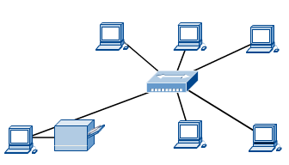
Computer Networks
Computer network connects two or more autonomous computers.
The computers can be geographically located anywhere.

Slide 22
Applications of Networks
Resource Sharing
Hardware (computing resources, disks, printers)
Software (application software)
Information Sharing
Easy accessibility from anywhere (files, databases)
Search Capability (WWW)
Communication
Email
Message broadcast
Remote computing
Distributed processing (Cloud Computing)

Slide 23
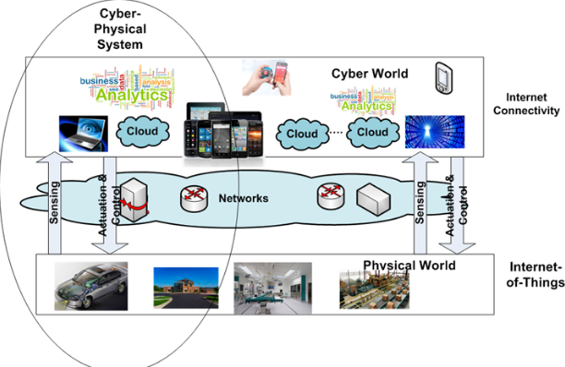
Some terms..CPS, IoT, Cloud

Slide 24
Network Components
Physical Media
Interconnecting Devices
Computers
Networking Software
Applications

Slide 25
Network Criteria
Performance
Depends on Network Elements
Measured in terms of Delay and Throughput
Reliability
Failure rate of network components
Measured in terms of availability/robustness
Security
Data protection against corruption/loss of data due to:
Errors
Malicious users

Slide 26
Physical Structures
Type of Connection
Point to Point - single transmitter and receiver
Multipoint - multiple recipients of single transmission
Physical Topology
Connection of devices
Type of transmission - unicast, mulitcast, broadcast

Slide 27
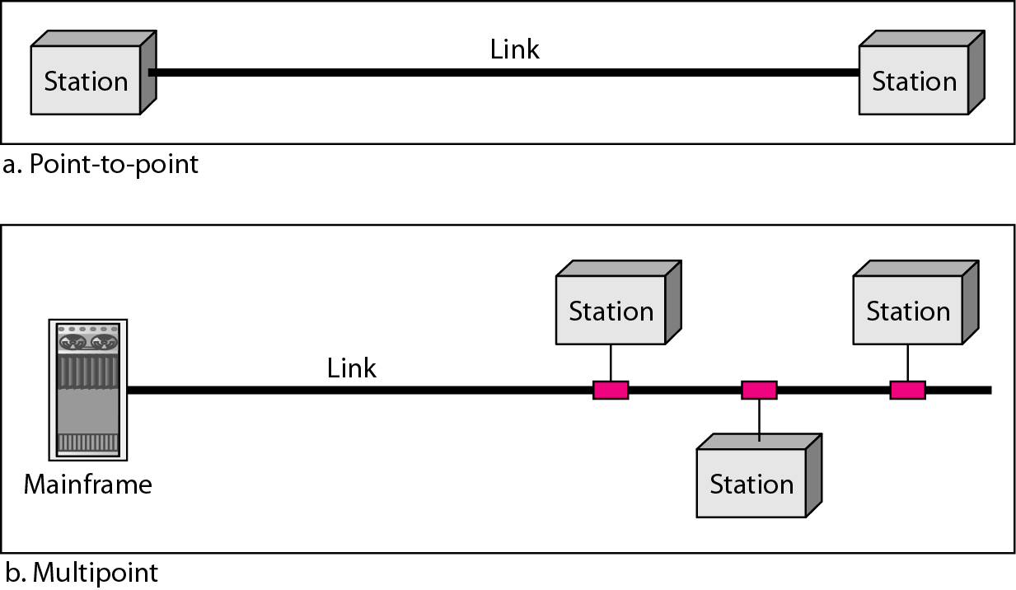
Types of Connections

Slide 28
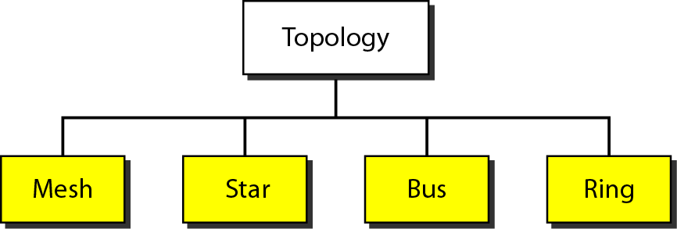
Categories of Topology

Slide 29
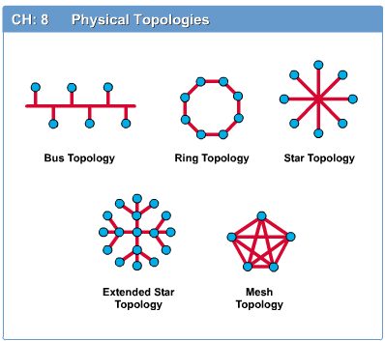
Network Topology
The network topology defines the way in which computers, printers, and other devices are connected. A network topology describes the layout of the wire and devices as well as the paths used by data transmissions.

Slide 30
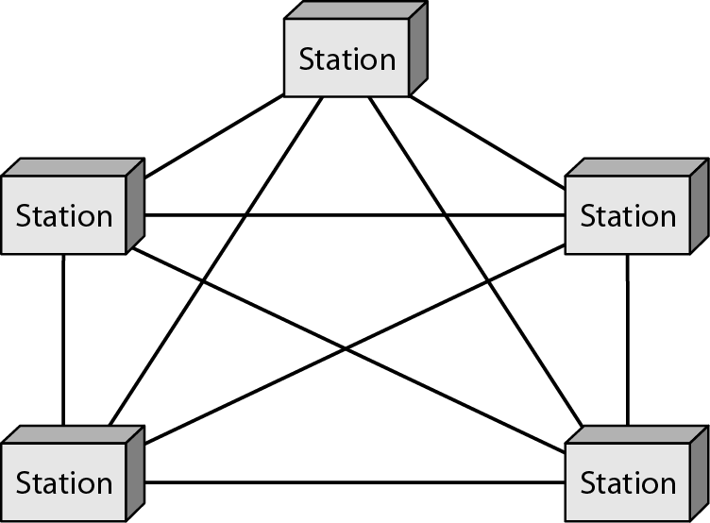
A fully connected mesh topology (five devices)

Slide 31
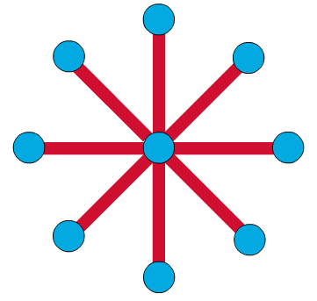
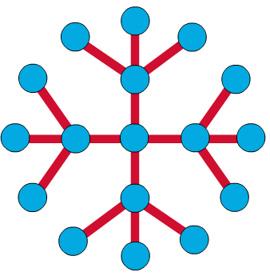
Star Topology
The star topology is the most commonly used architecture in Ethernet LANs.
Larger networks use the extended star topology also called tree topology. When used with network devices that filter frames or packets, like bridges, switches, and routers, this topology significantly reduces the traffic on the wires by sending packets only to the wires of the destination host.

Slide 32
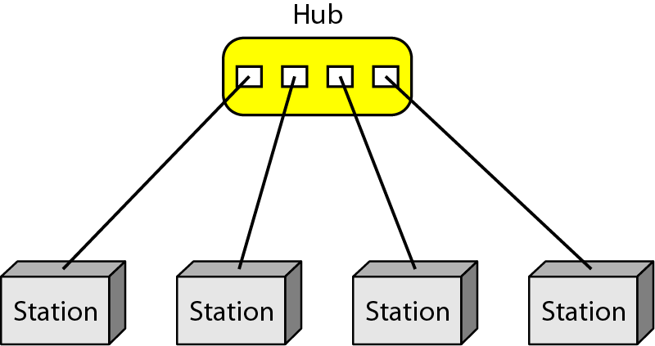
A star topology connecting four stations

Slide 33
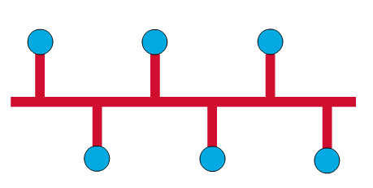
Bus Topology
Commonly referred to as a linear bus, all the devices on a bus topology are connected by one single cable.

Slide 34
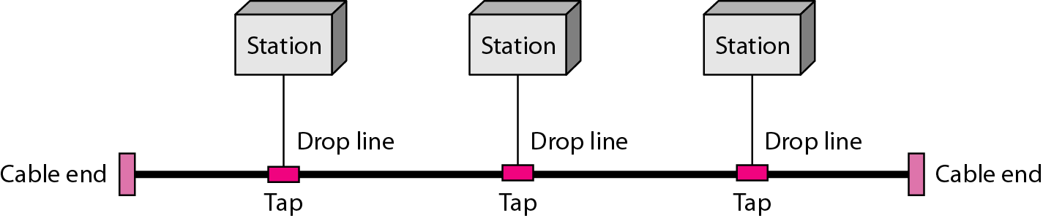
A bus topology connecting three stations

Slide 35
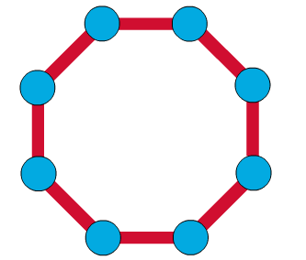
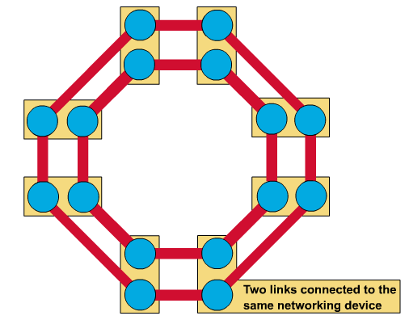
Ring Topology
A frame travels around the ring, stopping at each node. If a node wants to transmit data, it adds the data as well as the destination address to the frame.
The frame then continues around the ring until it finds the destination node, which takes the data out of the frame.
Single ring – All the devices on the network share a single cable
Dual ring – The dual ring topology allows data to be sent in both directions.

Slide 36
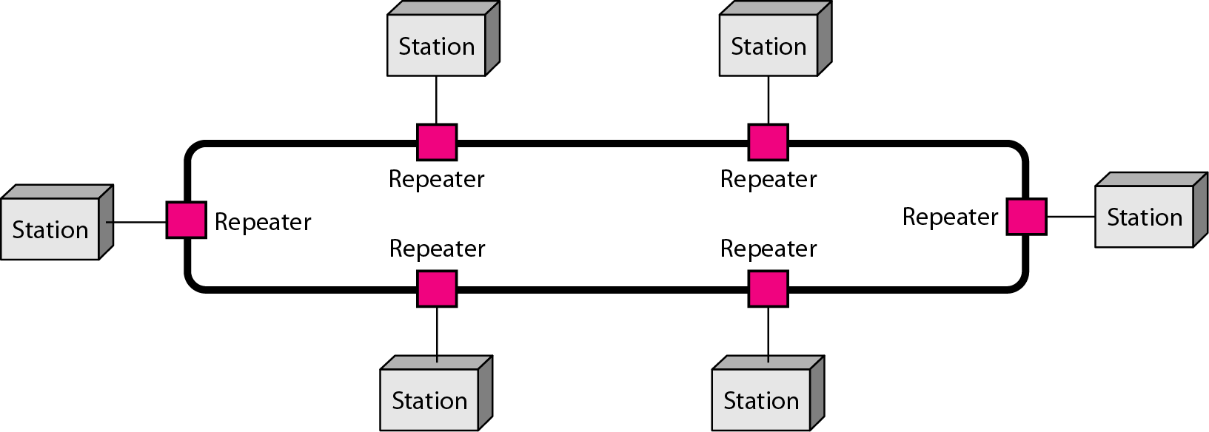
A ring topology connecting six stations

Slide 37
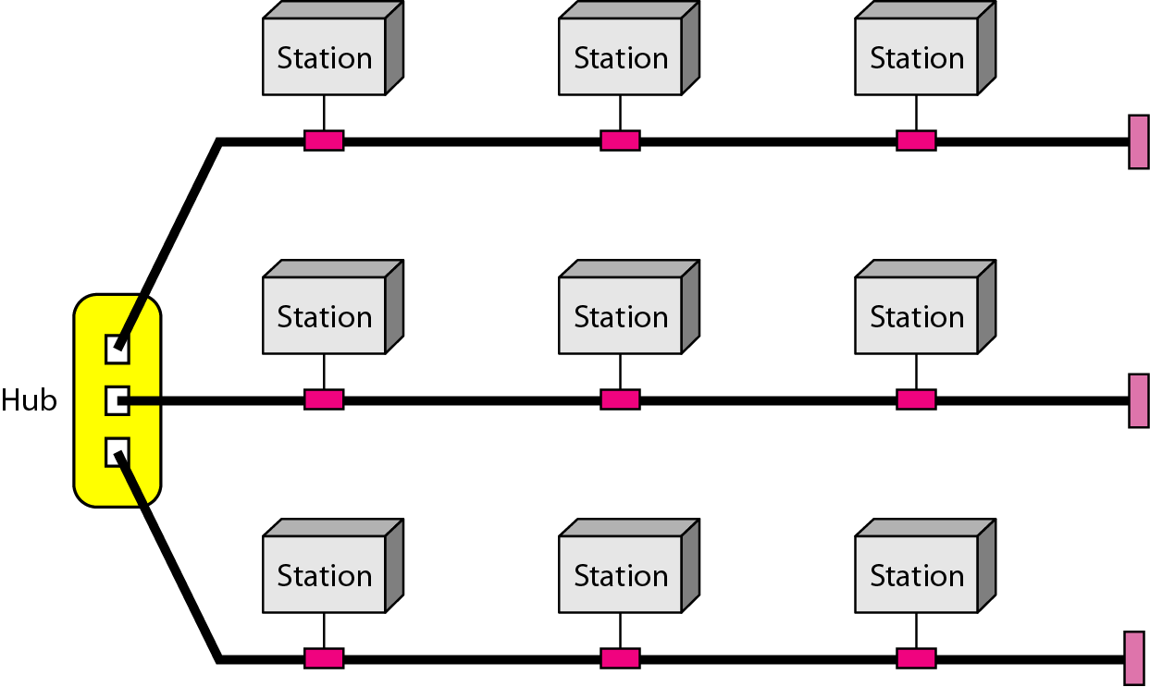
A hybrid topology: a star backbone with three bus networks

Slide 38
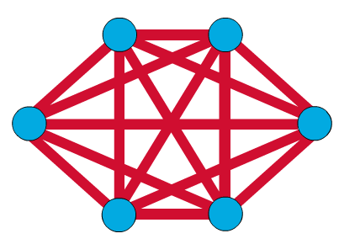
Mesh Topology
The mesh topology connects all devices (nodes) to each other for redundancy and fault tolerance.
It is used in WANs to interconnect LANs and for mission critical networks like those used by banks and financial institutions.
Implementing the mesh topology is expensive and difficult.

Slide 39
Categories of Networks
Local Area Networks (LANs)
Short distances
Designed to provide local interconnectivity
Wide Area Networks (WANs)
Long distances
Provide connectivity over large areas
Metropolitan Area Networks (MANs)
Provide connectivity over areas such as a city, a campus

Slide 40
LAN, MAN and WAN
Network in small geographical Area (Room, Building or a Campus) is called LAN (Local Area Network)
Network in a City is call MAN (Metropolitan Area Network)
Network spread geographically (Country or across Globe) is called WAN (Wide Area Network)

Slide 41
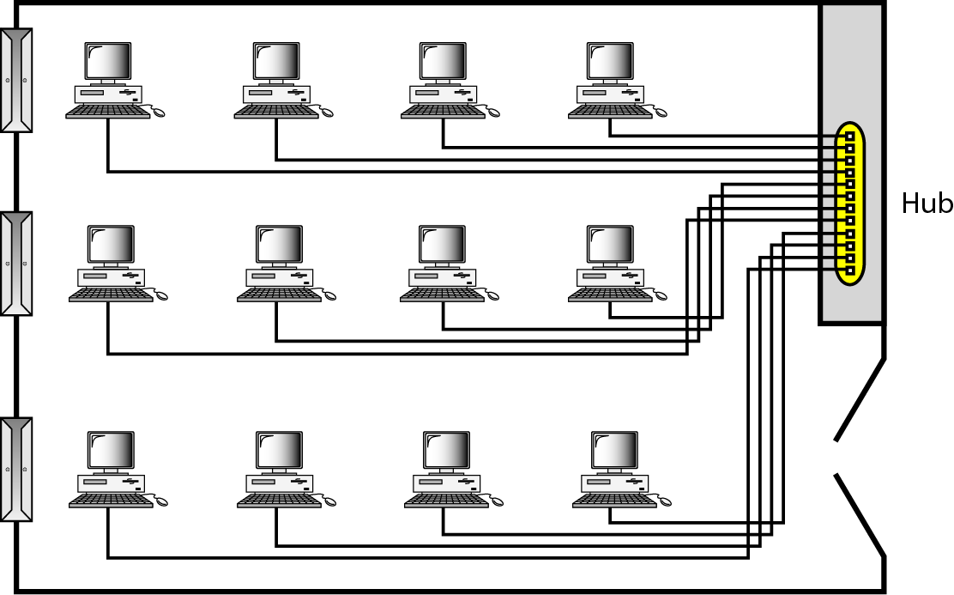
LAN

Slide 42
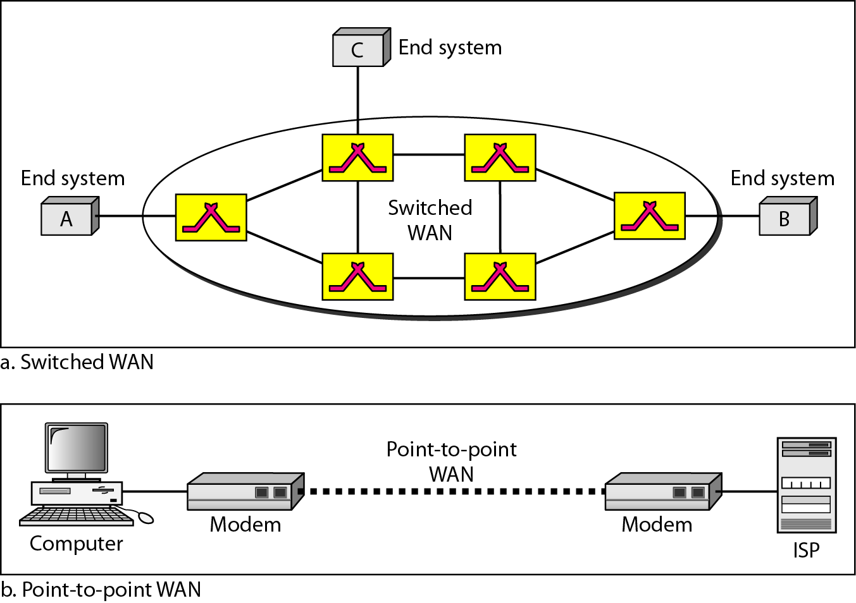
WANs: a switched WAN and a point-to-point WAN

Slide 43
WAN technologies
There are two types of long distance communication technologies that are used for WANs.
Dedicated connection
A dedicated line is a full-time point-to-point connection provided by a communication carrier that lasts for the length of the lease period.
Switched connection
There are several types of switched connections: circuit switched, packet switched, and cell switched

Slide 44
Circuit Switching
In circuit switching, circuits are established prior to the transmission of data and torn down at the end of the transmission.
During transmission of data, all of the packets take the same path.
The Public Switch Telephone Network (PSTN) is an example of a circuit switch system.
A call is placed and a circuit established when the other end of the circuit is answered.
Modems that operate between computer systems are a specific example.

Slide 45
Packet Switching
In packet switching, circuits may be selected on a packet-by-packet basis.
The Internet widely uses packet switch networks, for individual packets in the same transmission may take different routes through the network to the same destination.
Upper layers of the OSI model place the packets into the correct order.

Slide 46
Cell Switching
Cell switching is associated with Asynchronous Transmission Mode (ATM) which is considered to be a high speed switching technology that attempted to overcome the speed problems faced by the shared media like Ethernet.
Cell switching uses a connection-oriented packet-switched network.
It is called cell switching because this methodology uses a fixed length of packets of 53 bytes out of which 5 bytes are reserved for header.
Unlike cell technology, packet switching technology uses variable length packets.
Even though cell switching closely resembles packet switching because cell switching also breaks the information into smaller packets of fixed length.

Slide 47
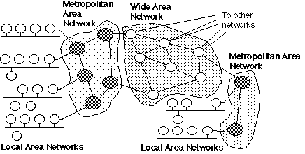
LAN→MAN→ WAN

Slide 48
INTERNET
Big and getting bigger….

Slide 49
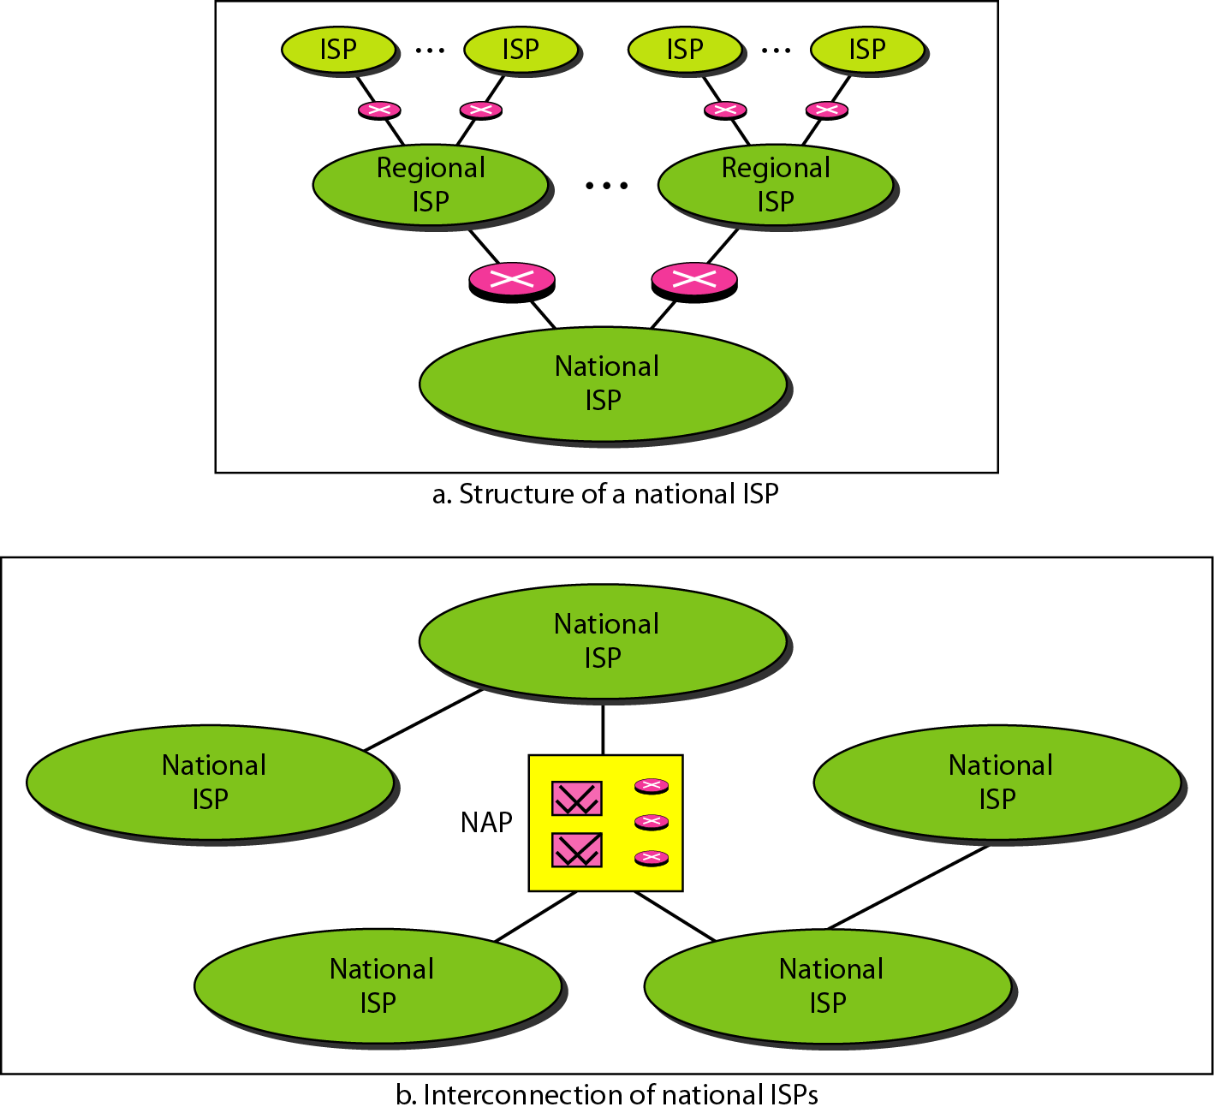
Hierarchical organization of the Internet

Slide 50
Protocols
A protocol is synonymous with rule. It consists of a set of rules that govern data communications. It determines -
what is communicated
how it is communicated and
when it is communicated.
The key elements of a protocol are syntax, semantics and timing

Slide 51
Elements of a Protocol
Syntax
Structure or format of the data
Indicates how to read the bits - field delineation
Semantics
Interprets the meaning of the bits
Knows which fields define what action
Timing
When data should be sent and
What speed at which data should be sent or speed at which it is being received.

Slide 52
Network models

Slide 53
Communication Architecture
Strategy for connecting host computers and other communicating equipment.
Defines necessary elements for data communication between devices.
A communication architecture, therefore, defines a standard for the communicating hosts.
A programmer formats data in a manner defined by the communication architecture and passes it on to the communication software.
Separating communication functions adds flexibility, for example, we do not need to modify the entire host software to include more communication devices.

Slide 54
Example
We use the concept of layers in our daily life. As an example, let us consider two friends who communicate through postal mail. The process of sending a letter to a friend would be complex if there were no services available from the post office.

Slide 55
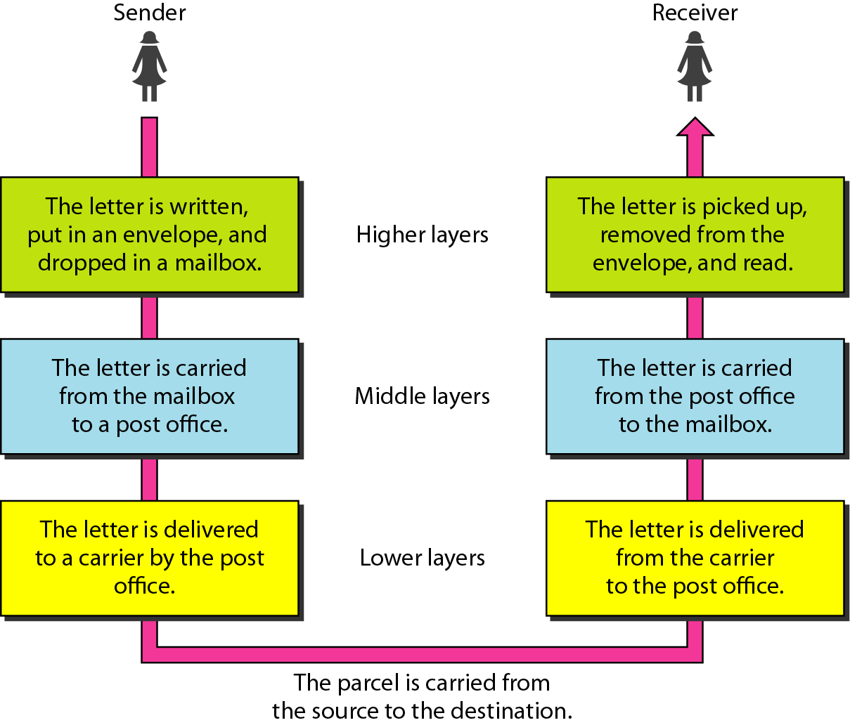
Tasks involved in sending a letter

Slide 56
Layer Architecture
Layer architecture simplifies the network design.
It is easy to debug network applications in a layered architecture network.
The network management is easier due to the layered architecture.
Network layers follow a set of rules, called protocol.
The protocol defines the format of the data being exchanged, and the control and timing for the handshake between layers.

Slide 57
ISO or OSI
ISO (International Organization for Standardization)
is the organization.
OSI (Open Systems Interconnection )
is the model.

Slide 58
Open Systems Interconnection (OSI) Model
International standard organization (ISO) established a committee in 1977 to develop an architecture for computer communication.
Open Systems Interconnection (OSI) reference model is the result of this effort.
In 1984, the Open Systems Interconnection (OSI) reference model was approved as an international standard for communications architecture.
Term “open” denotes the ability to connect any two systems which conform to the reference model and associated standards.

Slide 59
OSI Reference Model
The OSI model is now considered the primary Architectural model for inter-computer communications.
The OSI model describes how information or data makes its way from application programmes (such as spreadsheets) through a network medium (such as wire) to another application programme located on another network.
The OSI reference model divides the problem of moving information between computers over a network medium into SEVEN smaller and more manageable problems .
This separation into smaller more manageable functions is known as layering.

Slide 60
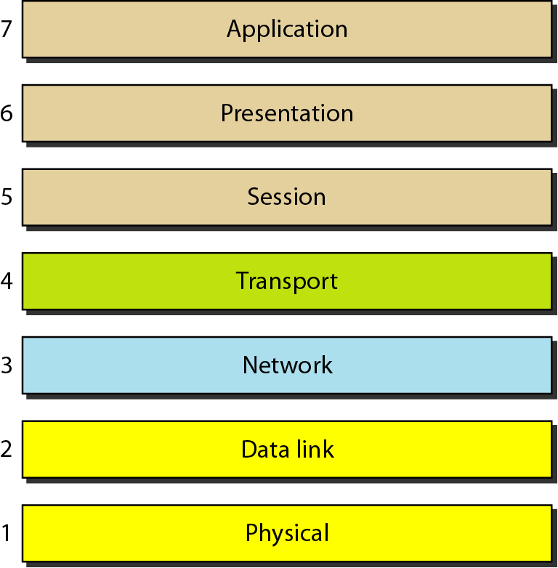
OSI Model

Slide 61
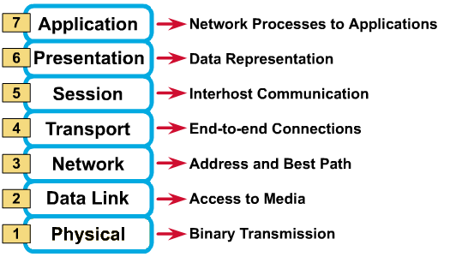
OSI Reference Model: 7 Layers

Slide 62
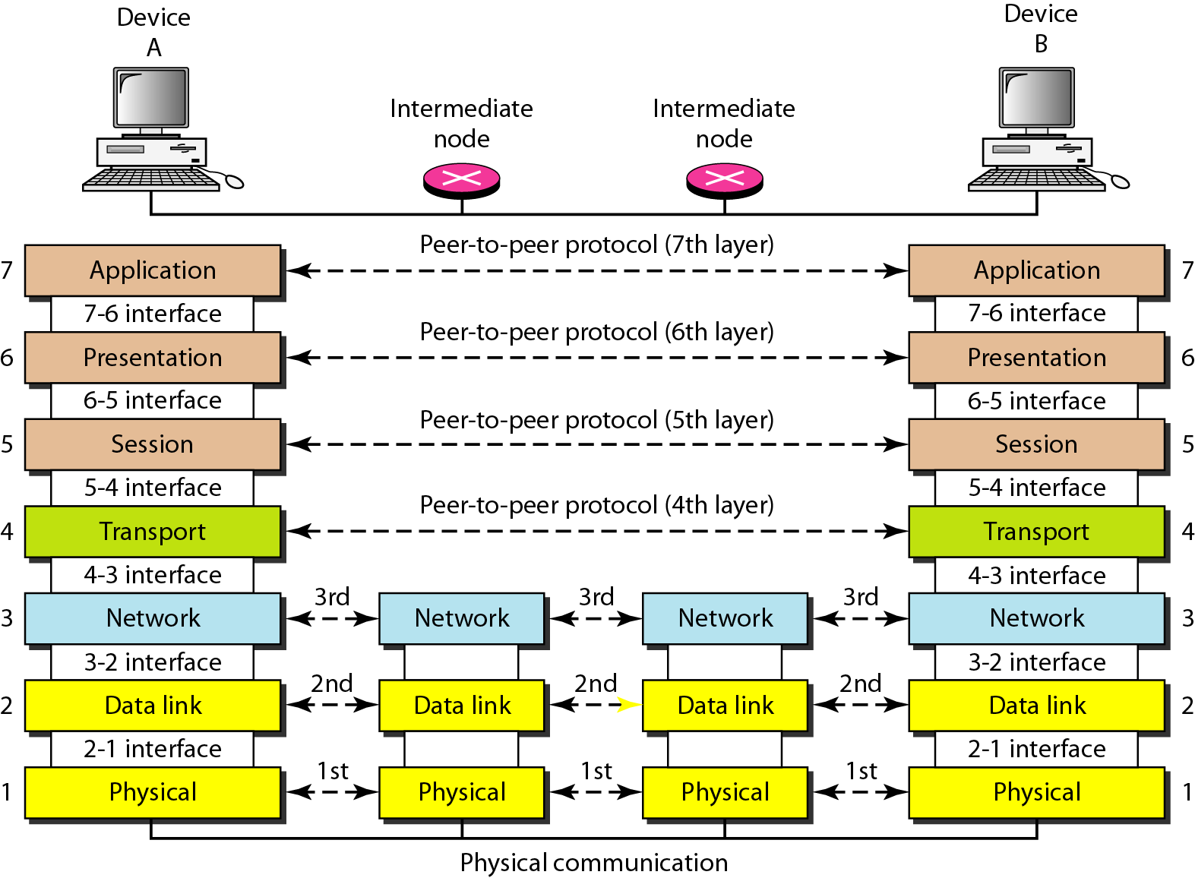
The interaction between layers in the OSI model

Slide 63
OSI: A Layered Network Model
The process of breaking up the functions or tasks of networking into layers reduces complexity.
Each layer provides a service to the layer above it in the protocol specification.
Each layer communicates with the same layer’s software or hardware on other computers.
The lower 4 layers (transport, network, data link and physical —Layers 4, 3, 2, and 1) are concerned with the flow of data from end to end through the network.
The upper three layers of the OSI model (application, presentation and session—Layers 7, 6 and 5) are orientated more toward services to the applications.
Data is Encapsulated with the necessary protocol information as it moves down the layers before network transit.

Slide 64
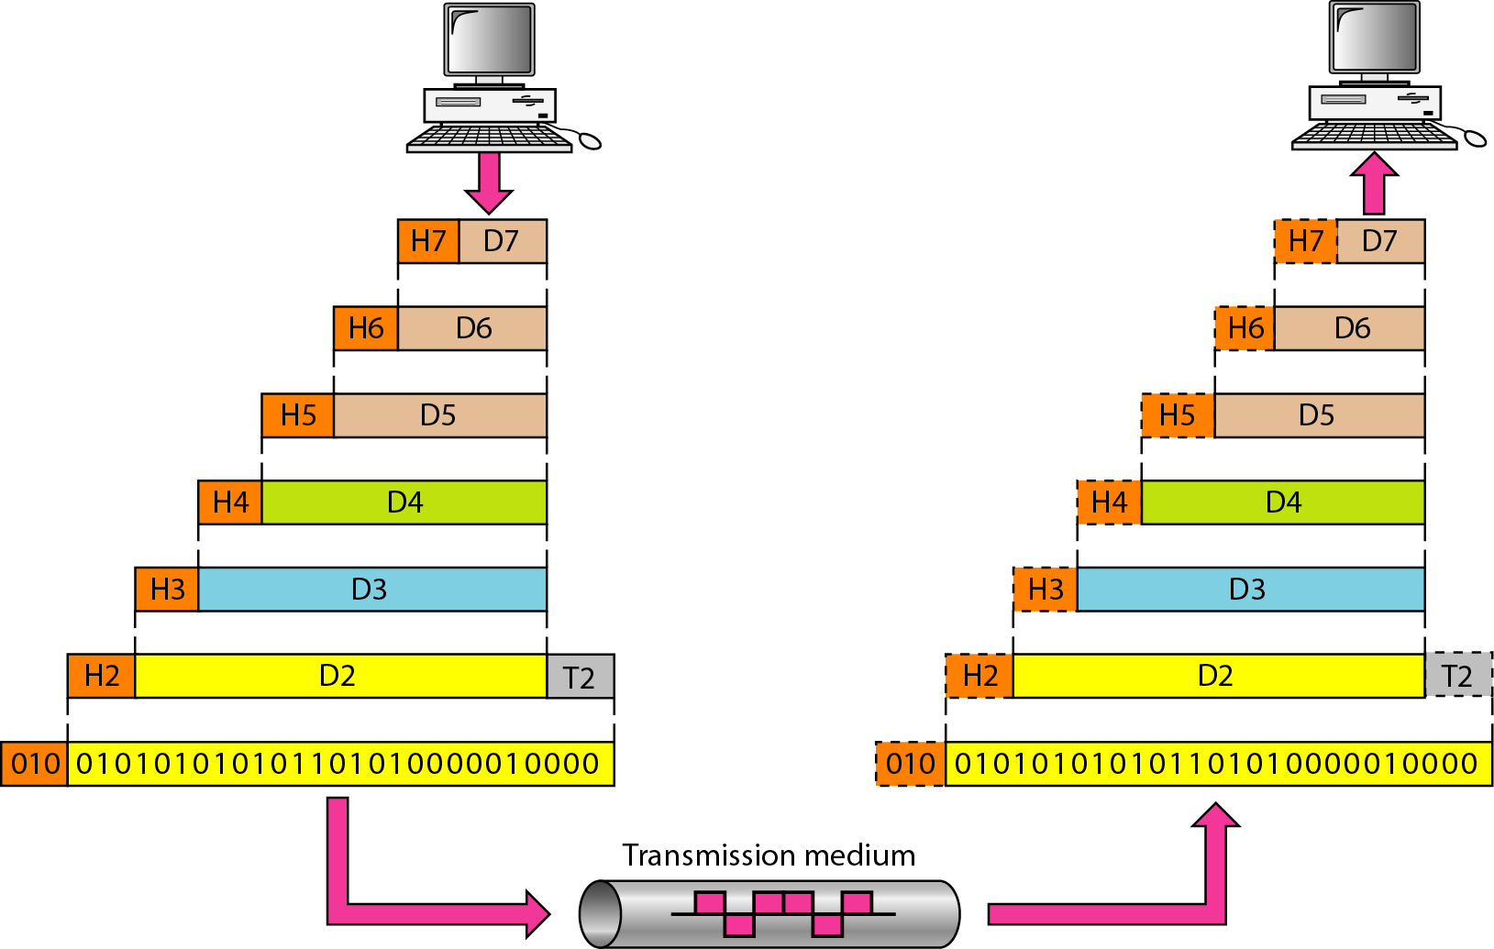
An exchange using the OSI model

Slide 65
Physical Layer
OSI Model
Provides physical interface for transmission of information.
Defines rules by which bits are passed from one system to another on a physical communication medium.
Covers all - mechanical, electrical, functional and procedural - aspects for physical communication.
Such characteristics as voltage levels, timing of voltage changes, physical data rates, maximum transmission distances, physical connectors, and other similar attributes are defined by physical layer specifications.

Slide 66
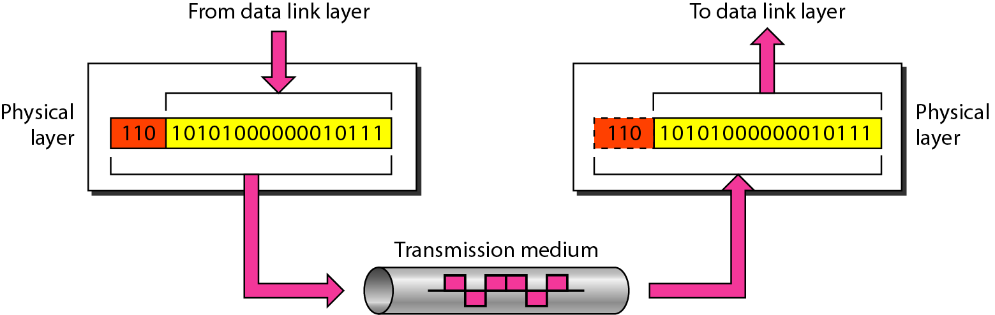
Physical Layer
The physical layer is responsible for movements of
individual bits from one hop (node) to the next.

Slide 67
Data Link Layer
OSI Model
Data link layer attempts to provide reliable communication over the physical layer interface.
Breaks the outgoing data into frames and reassemble the received frames.
Create and detect frame boundaries.
Handle errors by implementing an acknowledgement and retransmission scheme.
Implement flow control.
Supports points-to-point as well as broadcast communication.
Supports simplex, half-duplex or full-duplex communication.

Slide 68
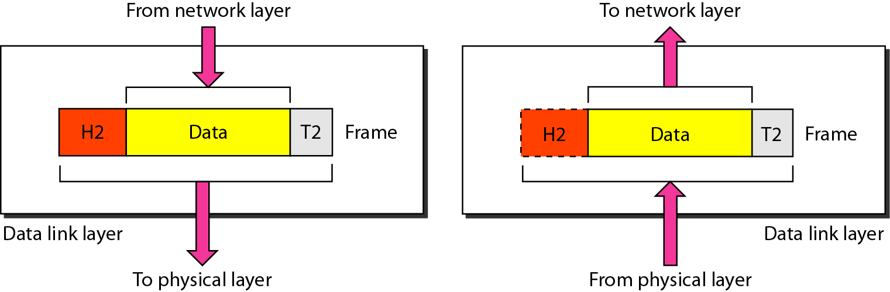
Data Link Layer
The data link layer is responsible for moving frames from one hop (node) to the next.

Slide 69
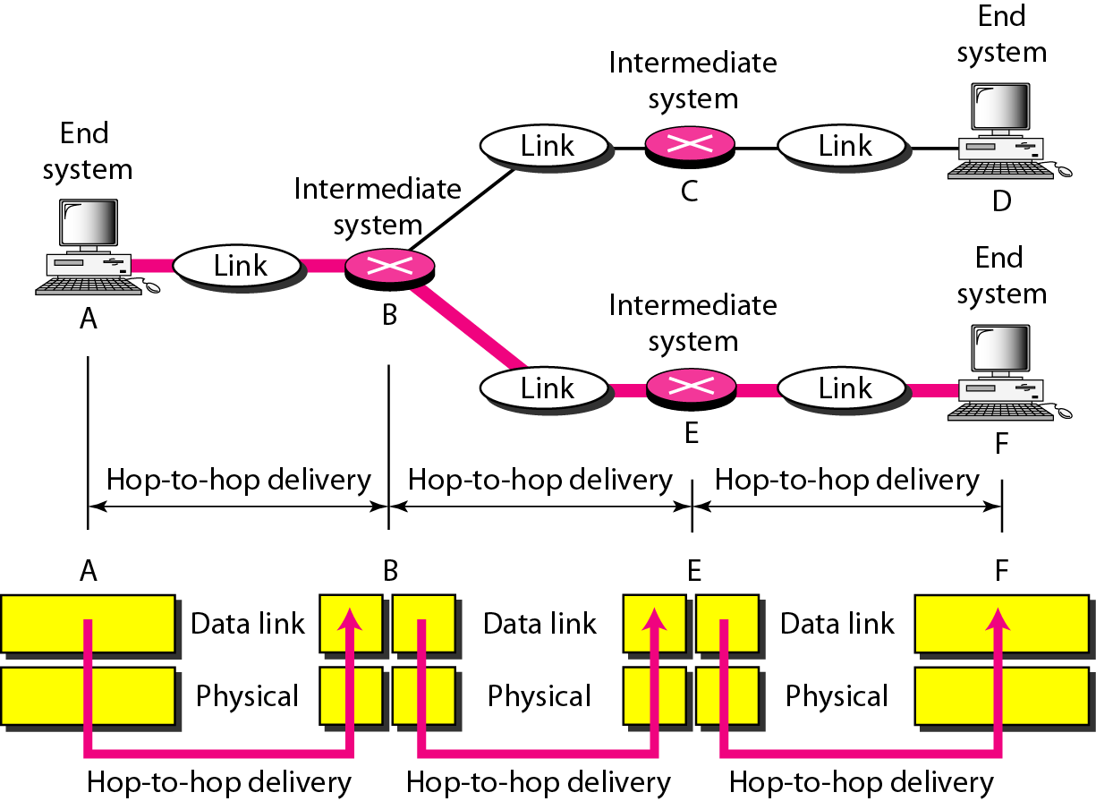
Hop to Hop Delivery

Slide 70
Network Layer
Implements routing of frames (packets) through the network.
Defines the most optimum path the packet should take from the source to the destination
Defines logical addressing so that any endpoint can be identified.
Handles congestion in the network.
Facilitates interconnection between heterogeneous networks (Internetworking).
The network layer also defines how to fragment a packet into smaller packets to accommodate different media.

Slide 71
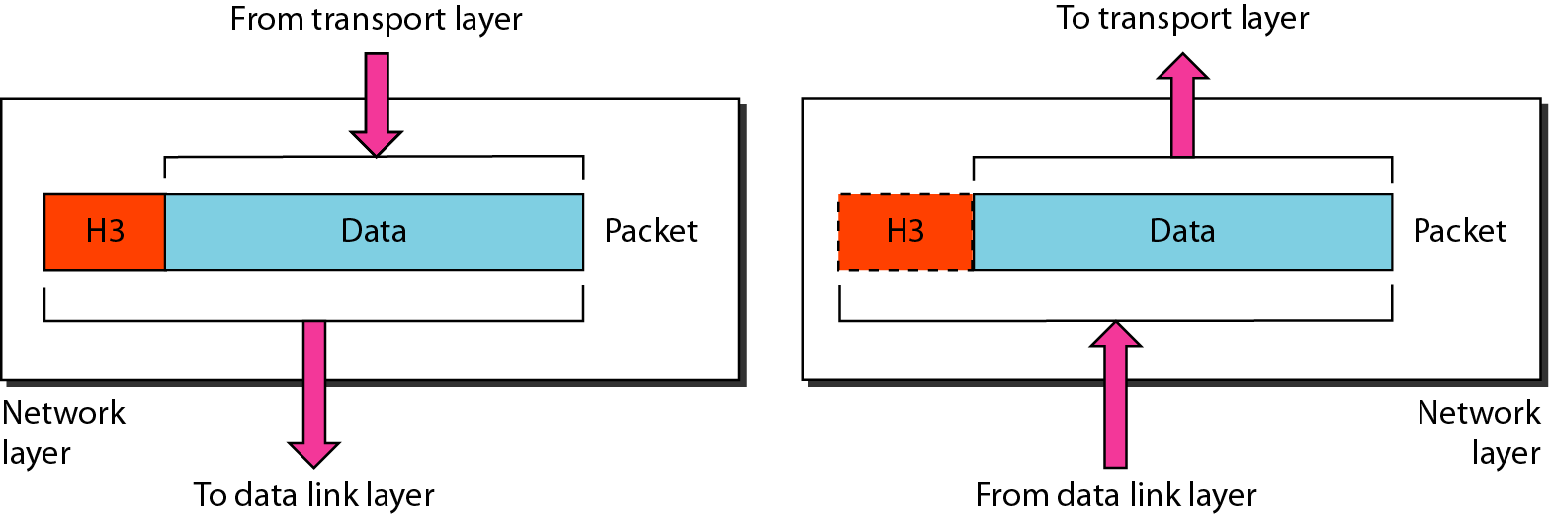
Network Layer
The network layer is responsible for the delivery of individual packets from the source host to the destination host.

Slide 72
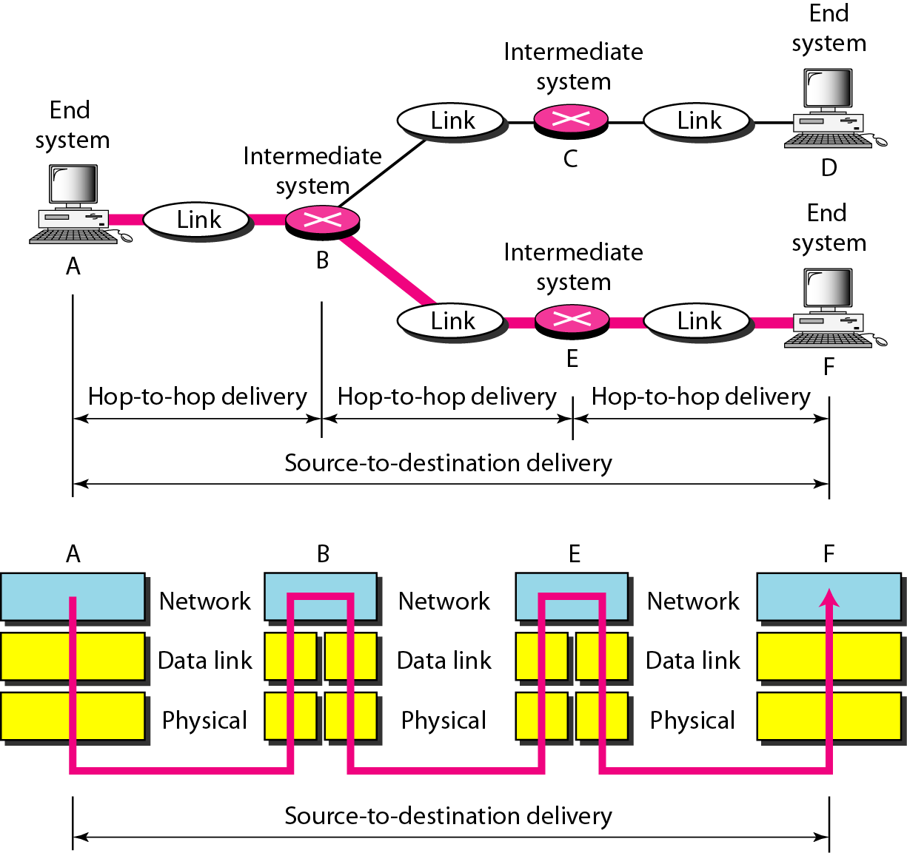
Source to destination delivery

Slide 73
Transport Layer
OSI Model
Purpose of this layer is to provide a reliable mechanism for the exchange of data between two processes in different computers.
Ensures that the data units are delivered error free.
Ensures that data units are delivered in sequence.
Ensures that there is no loss or duplication of data units.
Provides connectionless or connection oriented service.
Provides for the connection management.
Multiplex multiple connection over a single channel.

Slide 74
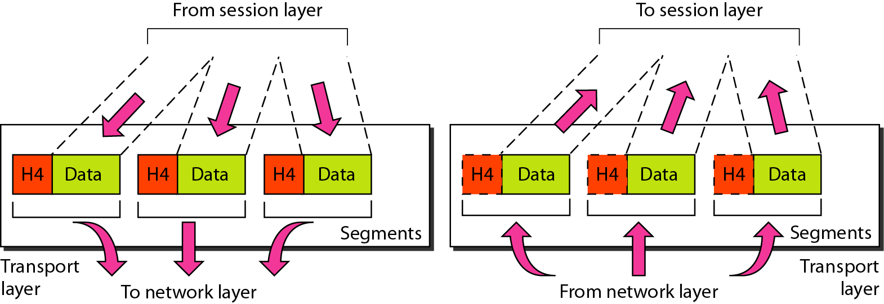
Transport Layer
The transport layer is responsible for the delivery of a message from one process to another.

Slide 75
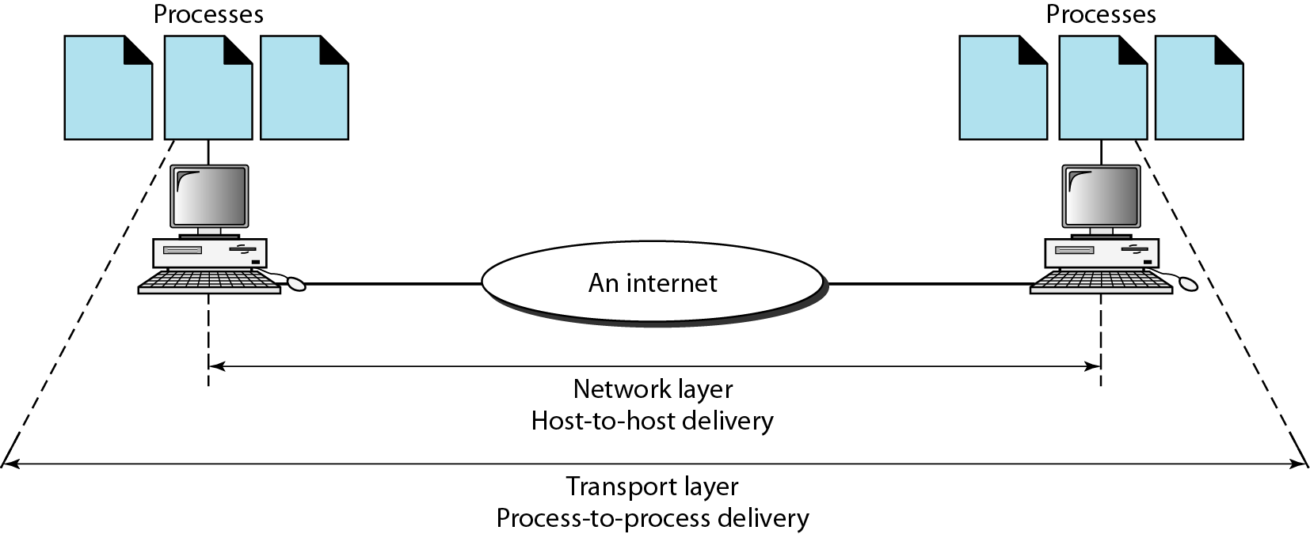
Reliable process-to-process delivery of a message

Slide 76
Session Layer
OSI Model
Session layer provides mechanism for controlling the dialogue between the two end systems. It defines how to start, control and end conversations (called sessions) between applications.
This layer requests for a logical connection to be established on an end-user’s request.
Any necessary log-on or password validation is also handled by this layer.
Session layer is also responsible for terminating the connection.
This layer provides services like dialogue discipline which can be full duplex or half duplex.
Session layer can also provide check-pointing mechanism such that if a failure of some sort occurs between checkpoints, all data can be retransmitted from the last checkpoint.

Slide 77
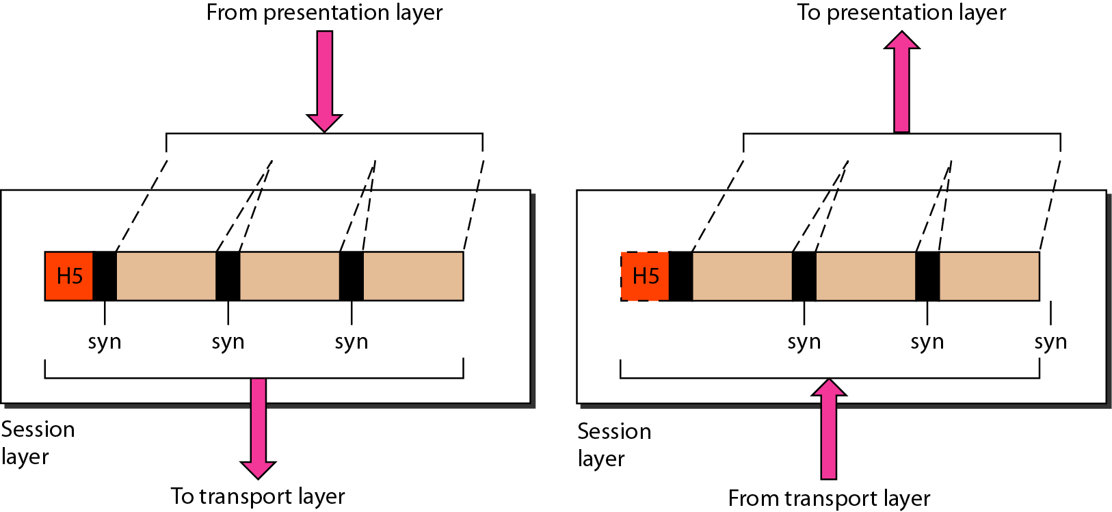
Session Layer
The session layer is responsible for dialog control and synchronization.

Slide 78
Presentation Layer
OSI Model
Presentation layer defines the format in which the data is to be exchanged between the two communicating entities.
Also handles data compression and data encryption (cryptography).

Slide 79
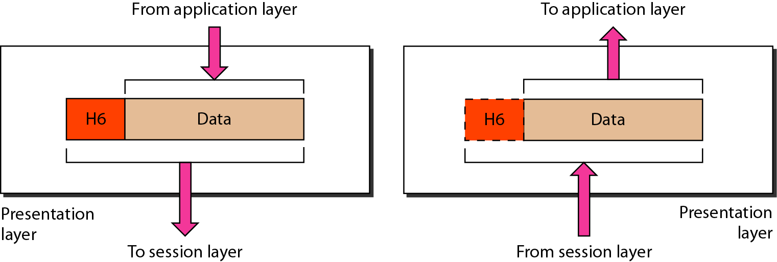
Presentation layer
The presentation layer is responsible for translation, compression, and encryption.

Slide 80
Application Layer
OSI Model
Application layer interacts with application programs and is the highest level of OSI model.
Application layer contains management functions to support distributed applications.
Examples of application layer are applications such as file transfer, electronic mail, remote login etc.

Slide 81
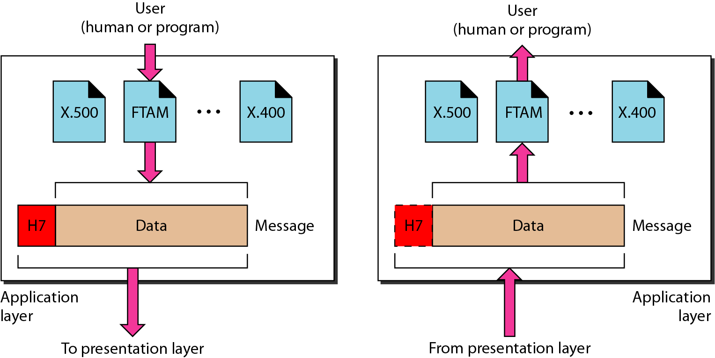
Application layer
The application layer is responsible for providing services to the user.

Slide 82
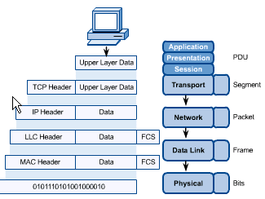
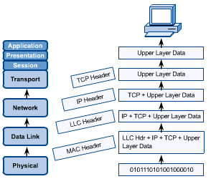
OSI in Action
OSI Model
A message begins at the top application layer and moves down the OSI layers to the bottom physical layer.
As the message descends, each successive OSI model layer adds a header to it.
A header is layer-specific information that basically explains what functions the layer carried out.
Conversely, at the receiving end, headers are striped from the message as it travels up the corresponding layers.

Slide 83
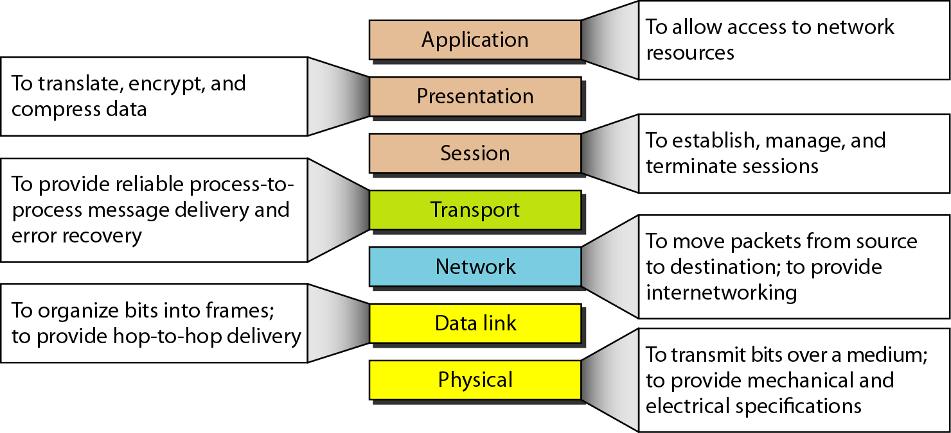
Summary of layers

Slide 84
TCP/IP Model
TCP/IP MODEL

Slide 85
TCP/IP protocol suite
The layers in the TCP/IP protocol suite do not exactly match those in the OSI model. The original TCP/IP protocol suite was defined as having four layers: host-to-network, internet, transport, and application. However, when TCP/IP is compared to OSI, we can say that the TCP/IP protocol suite is made of five layers: physical, data link, network, transport, and application.

Slide 86
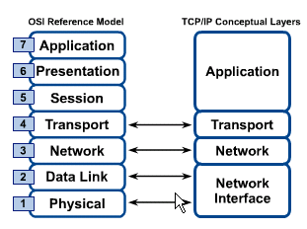
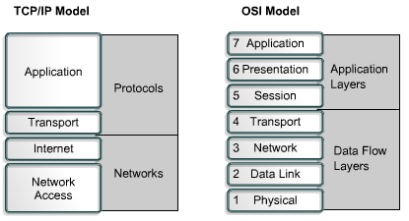
OSI & TCP/IP Models
TCP/IP Model

Slide 87
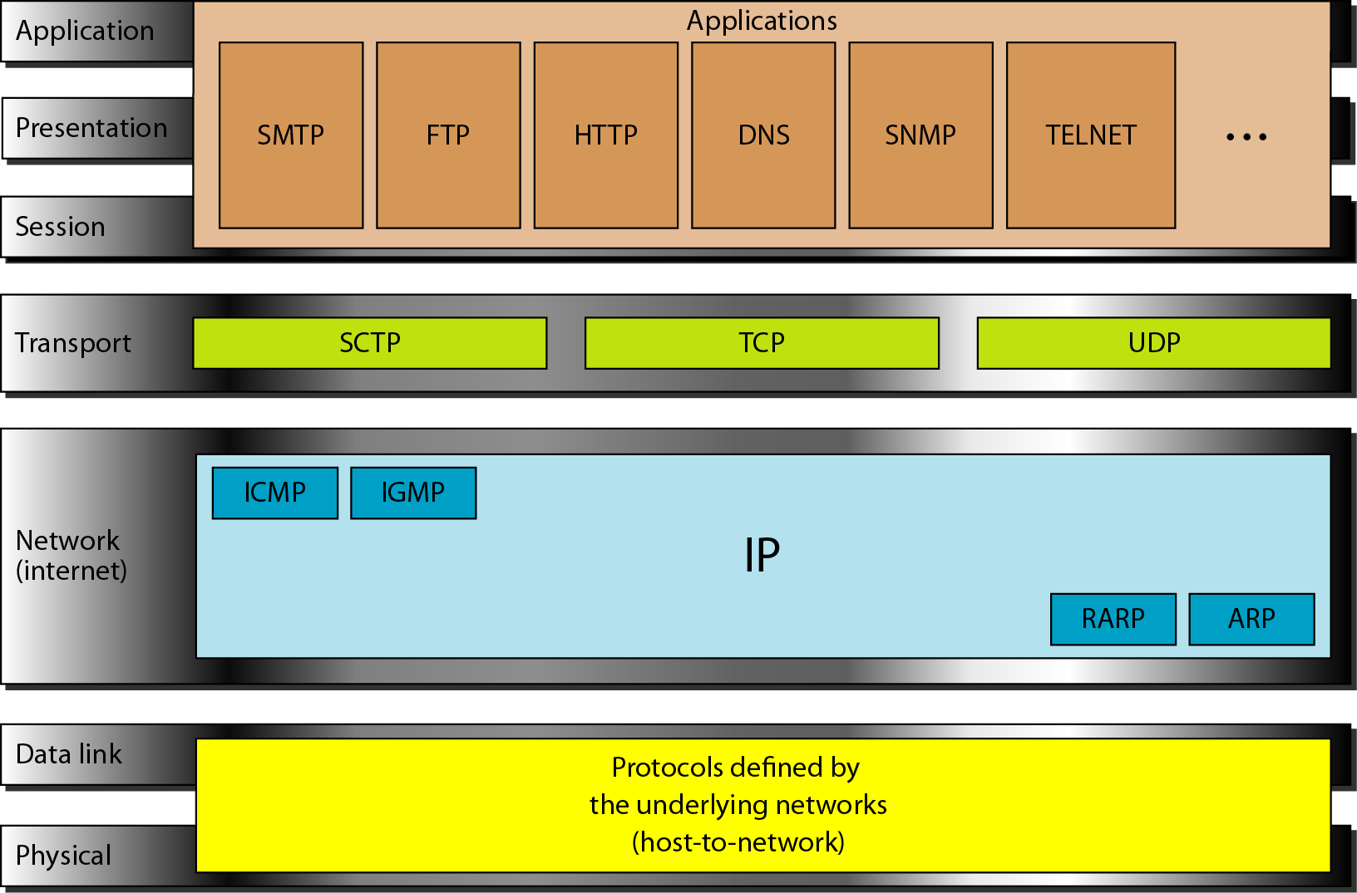
TCP/IP and OSI model

Slide 88
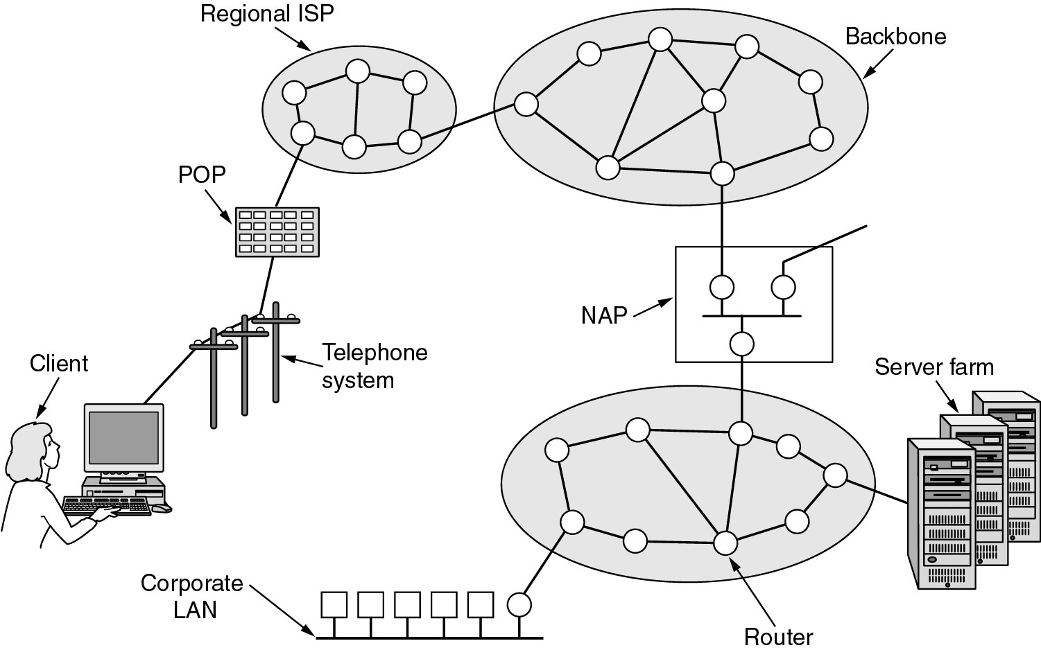
Overview of the Internet: TCP/IP reference model

Slide 89
TCP/IP Model
TCP/IP Model
Application Layer
Application programs using the network
Transport Layer (TCP/UDP)
Management of end-to-end message transmission,
error detection and error correction
Network Layer (IP)
Handling of datagrams : routing and congestion
Data Link Layer
Management of cost effective and reliable data delivery,
access to physical networks
Physical Layer
Physical Media

Slide 90
Addressing
Physical Addresses
Logical Addresses
Port Addresses
Specific Addresses

Slide 91
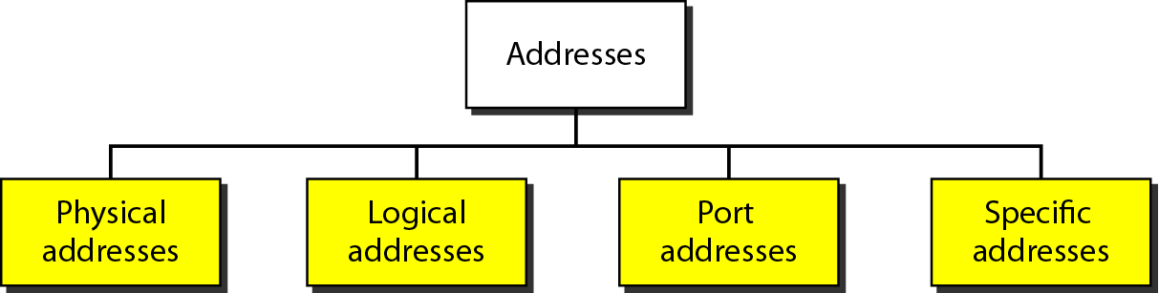
Addresses in TCP/IP

Slide 92
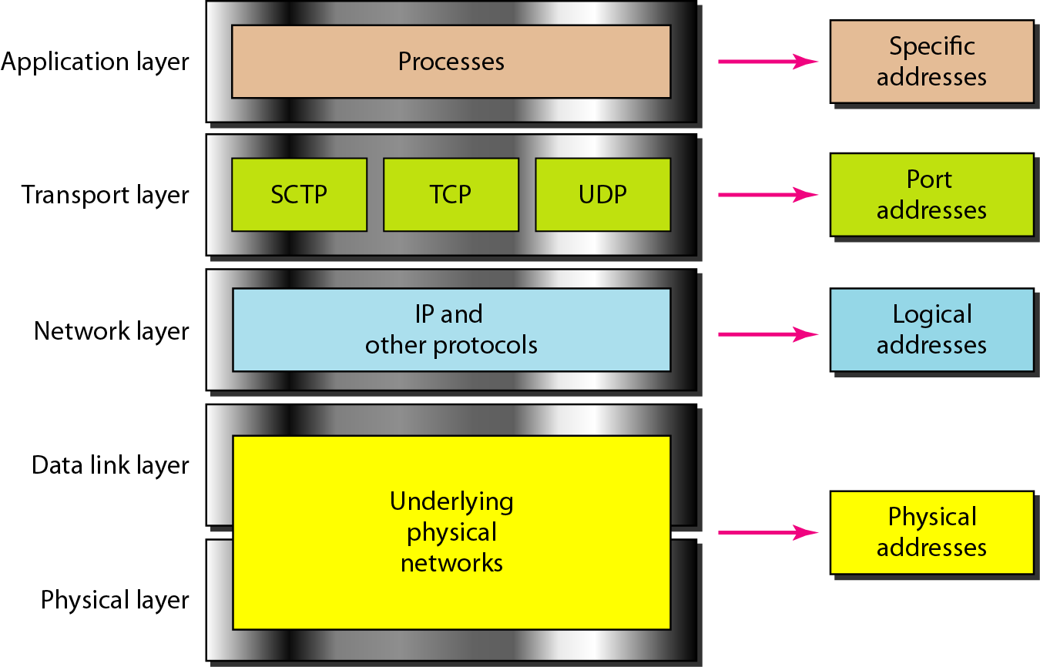
Relationship of layers and addresses in TCP/IP

Slide 93
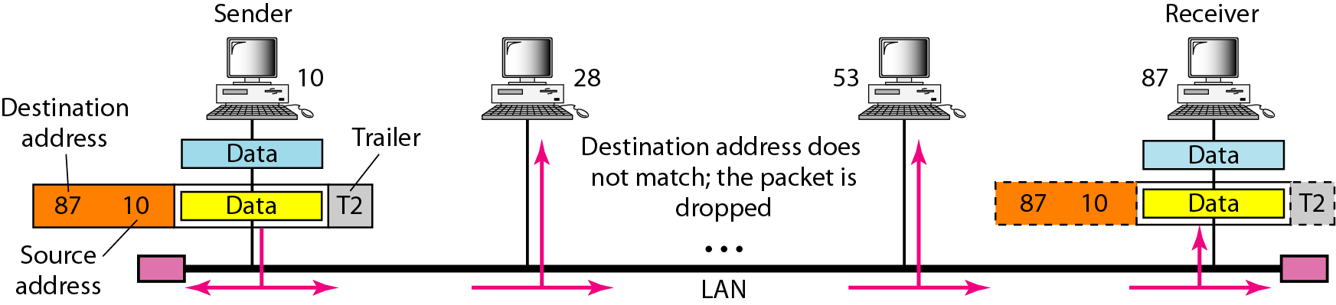
Physical Addresses
Here a node with physical address 10 sends a frame to a node with physical address 87. The two nodes are connected by a link (bus topology LAN). As the figure shows, the computer with physical address 10 is the sender, and the computer with physical address 87 is the receiver.

Slide 94
Most local-area networks use a 48-bit (6-byte) physical address written as 12 hexadecimal digits; every byte (2 hexadecimal digits) is separated by a colon, as shown below:
07:01:02:01:2C:4B
A 6-byte (12 hexadecimal digits) physical address.

Slide 95
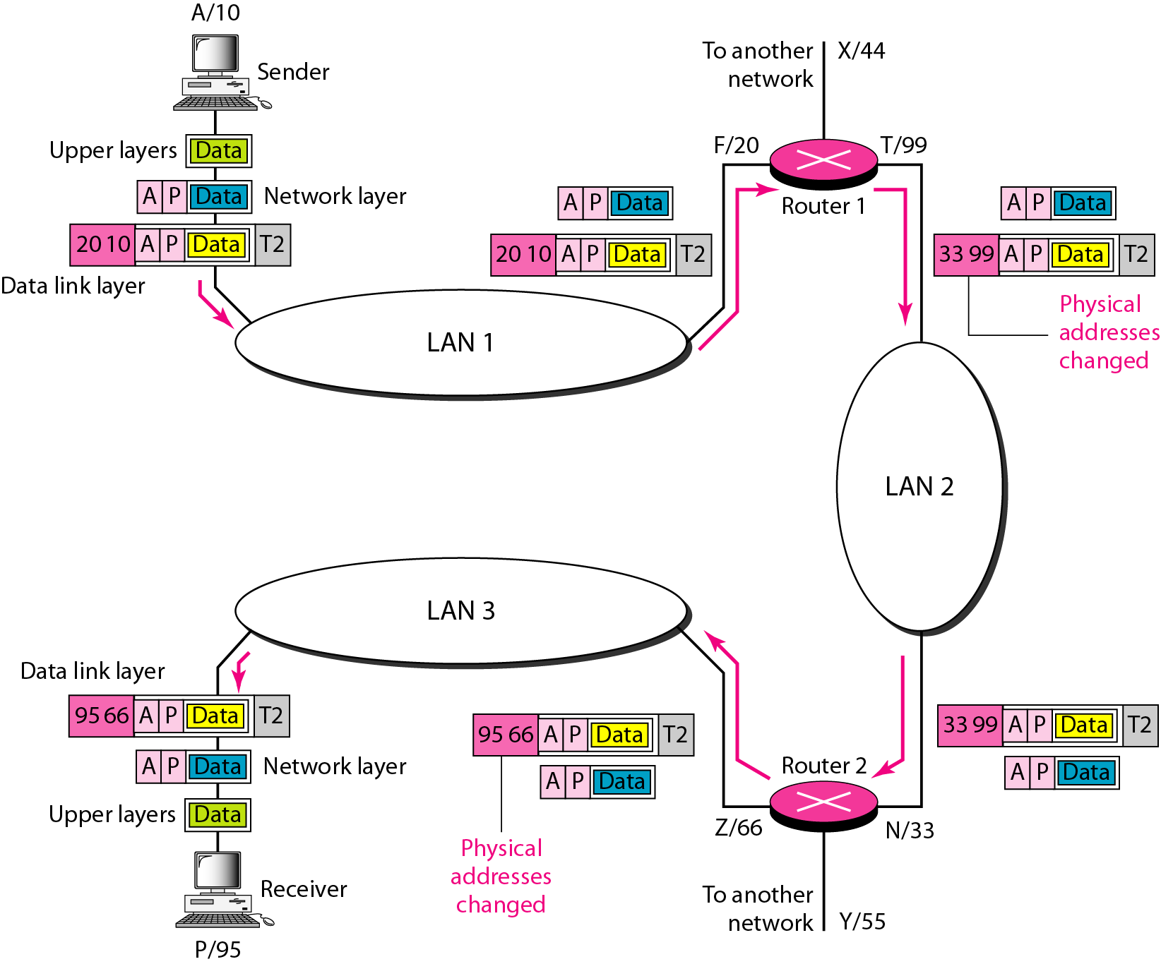
IP Addresses: A part of an internet with two routers connecting three LANs
Each device (computer or router) has a pair of addresses (logical and physical) for each connection.
In this case, each computer is connected to only one link and therefore has only one pair of addresses.
Each router, however, is connected to three networks (only two are shown in the figure).
So each router has three pairs of addresses, one for each connection.

Slide 96
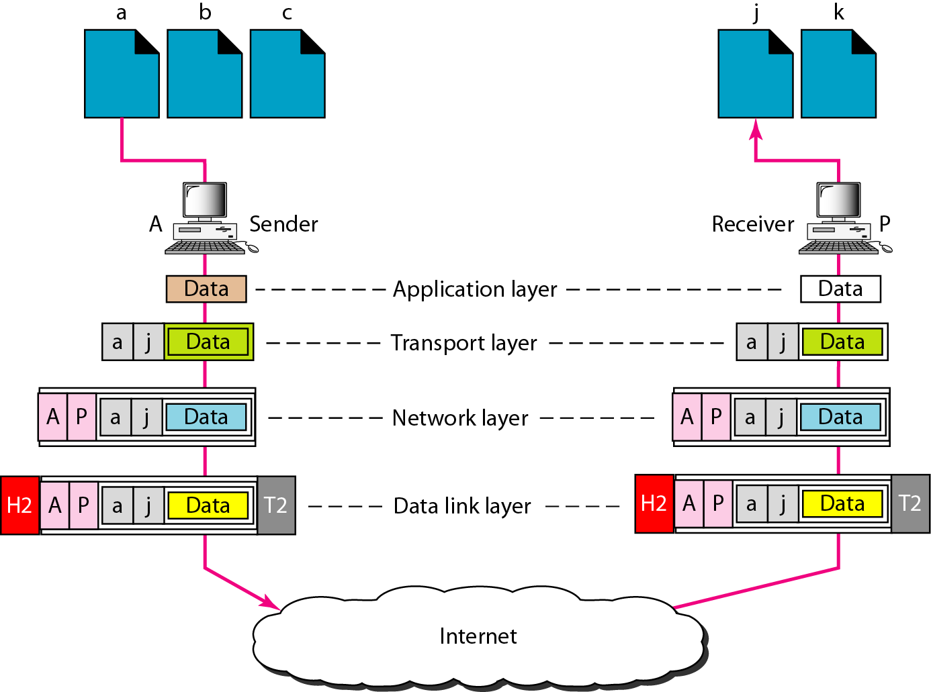
Port addresses
The sending computer is running three processes at this time with port addresses a, b, and c.
The receiving computer is running two processes at this time with port addresses j and k.
Process a in the sending computer needs to communicate with process j in the receiving computer.
Note that although physical addresses change from hop to hop, logical and port addresses remain the same from the source to destination.
The physical addresses will change from hop to hop,
but the logical addresses usually remain the same.

Slide 97
A port address is a 16-bit address represented by one decimal number as shown.
753
A 16-bit port address represented as one single number.

